Slide 1
AGRICULTURAL DATA ANALYSIS
Seasonal Agriculture Performance Analysis
How Kharif, Rabi & Zaid seasons shape yield, cost, and profitability across 4,000 farm records spanning 8 states, 8 crops, and 3 seasons
Kharif
Rabi
Zaid
5.50 t/ha · ₹1,70,101 profit · 34.4% ROI
4.98 t/ha · ₹86,254 profit · 17.4% ROI
4.64 t/ha · −₹23,235 loss · −2.3% ROI

Slide 2
EXECUTIVE SUMMARY
Three Seasons, Three Distinct Realities
A 4,000-record analysis reveals that seasonal timing is not merely an agronomic variable — it is the primary determinant of economic outcomes. The gap between Kharif and Zaid is not marginal; it is structural.
Kharif Dominates
Rabi Holds the Middle Ground
Highest yield at 5.50 t/ha, total profit of ₹1,70,101, ROI of 34.4%, and the best water efficiency of any season. 57.8% of Kharif farms are profitable — the highest across all seasons.
Moderate performance across all tracked metrics: 4.98 t/ha yield, ₹86,254 profit, 17.4% ROI. Nearly half of farms (48.9%) are profitable — a viable but underwhelming result.
Zaid Consistently Underperforms
The Statistical Verdict
Lowest yield (4.64 t/ha), average net loss of −₹23,235, ROI of −2.3%, and only 35.5% of farms profitable. Zaid represents a systemic failure of resource alignment.
Profit differs significantly by season (ANOVA p<0.00001). Critically, yield does not differ significantly (p=0.28) — confirming that cost structure and resource efficiency, not raw output, drive the profitability gap.

Slide 3
DATASET & SCOPE
Study Coverage & Variables Tracked
Dataset at a Glance
Variables Tracked Across Three Domains
4,000 farm records across 8 Indian states, 8 major crops, and 3 distinct agricultural seasons.
Environmental
Resource
Rainfall (mm)
Temperature (°C)
Humidity (%)
Soil moisture
Fertilizer use (kg/ha NPK)
Water use (m³/ha)
Irrigation method
Season Distribution
Kharif: 1,779 records (44.5%)
Rabi: 1,627 records (40.7%)
Zaid: 594 records (14.9%)
Economic
Yield (t/ha)
Profit / Loss (₹)
ROI (%)
Input cost

Slide 4
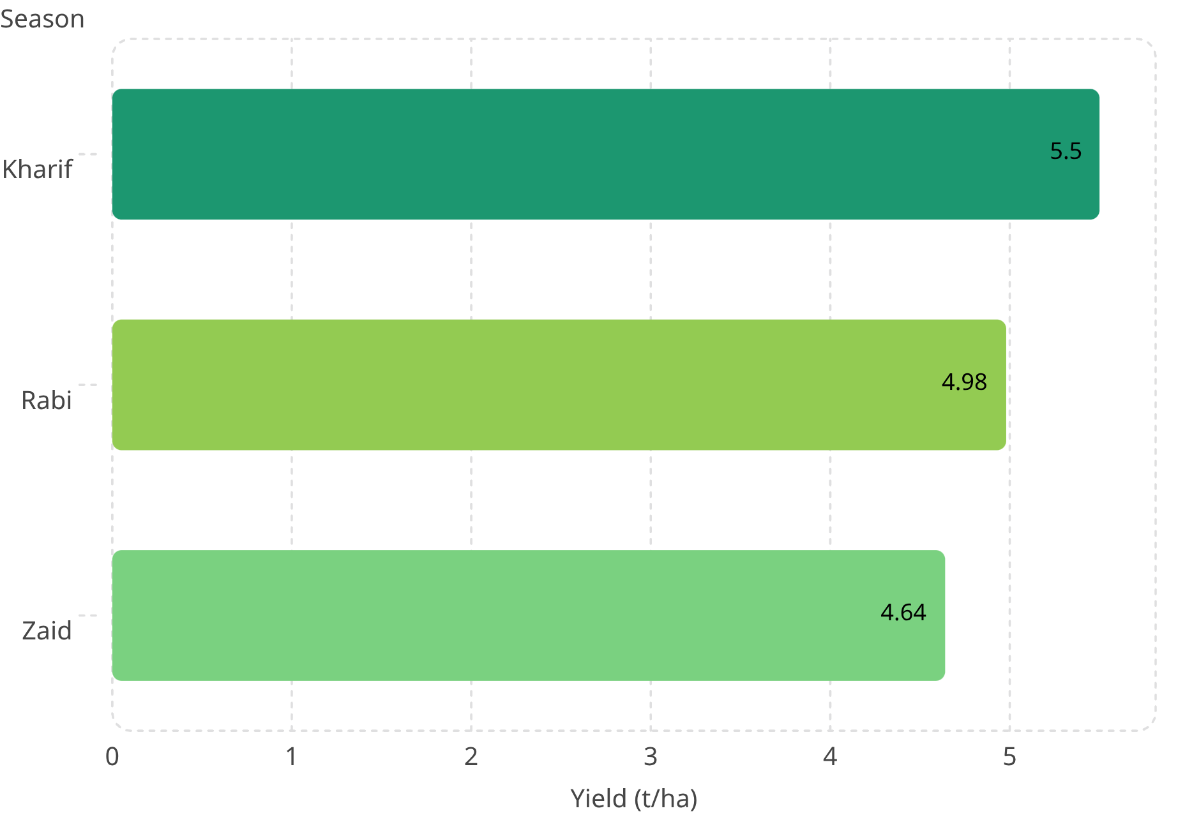
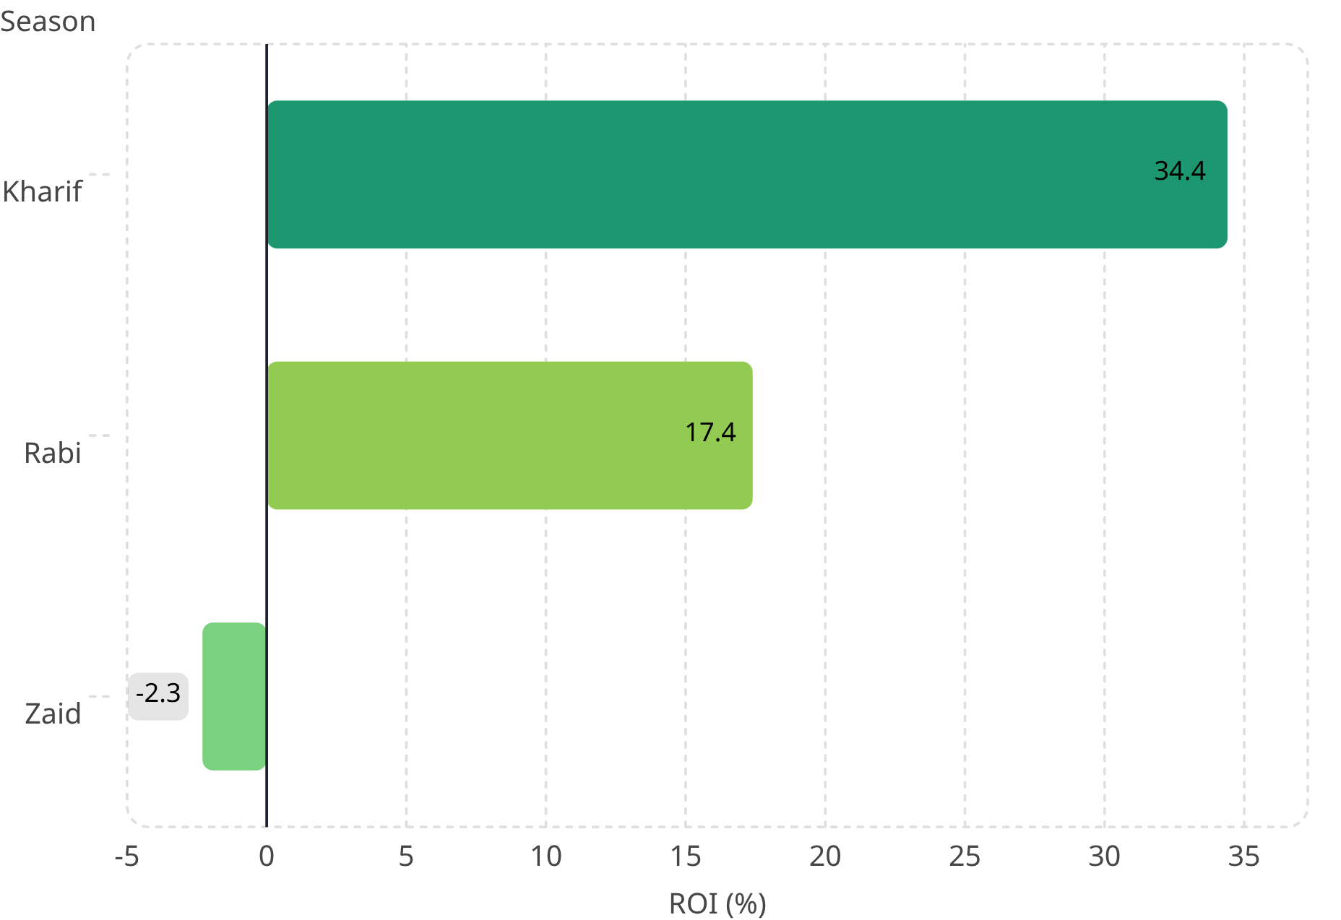
PERFORMANCE METRICS
Seasonal Performance Snapshot
Kharif
Rabi
5.50 t/ha yield · ₹1,70,101 profit
34.4% ROI · 57.8% farms profitable
4.98 t/ha yield · ₹86,254 profit
17.4% ROI · 48.9% farms profitable
Zaid
4.64 t/ha yield · −₹23,235 loss
−2.3% ROI · 35.5% farms profitable
ANOVA confirms profit differences are statistically significant (p<0.00001); yield differences are not (p=0.28).

Slide 5
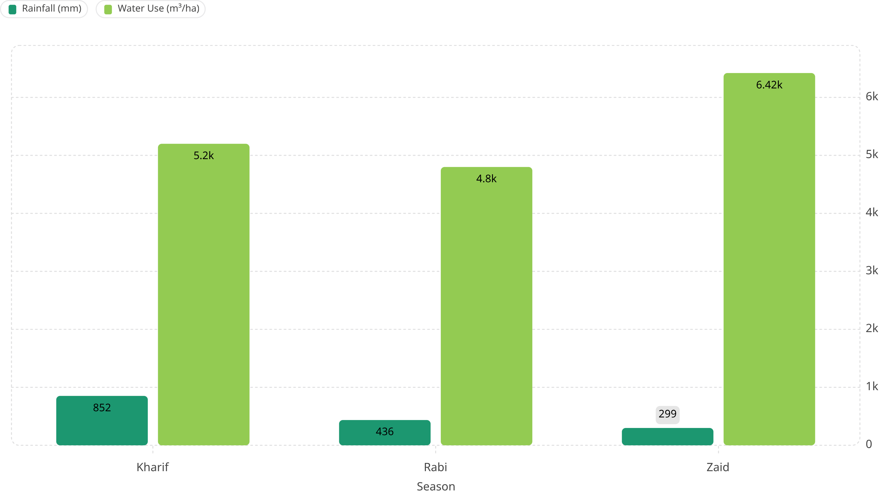
ENVIRONMENTAL & RESOURCE ANALYSIS
Environment & Resources by Season
Rainfall Decline
Temperature Gradient
Kharif 852mm → Rabi 436mm → Zaid 299mm. A 65% reduction from peak to trough season.
Kharif 28.5°C → Rabi 23.5°C → Zaid 31.0°C. Zaid is the hottest season, compounding water stress.
Water Usage Paradox
Fertilizer Input
Zaid uses 6,420 m³/ha — the highest of any season — despite being the driest. Irrigation practice is critically misaligned with climate.
NPK application is nearly flat across all seasons at approximately ~185 kg/ha. Fertilizer is not a differentiating variable.

Slide 6
YIELD–ENVIRONMENT DISCONNECT
The Yield-Environment Disconnect
Conventional wisdom suggests that better rainfall and milder temperatures produce higher yields. The data tells a more nuanced story: climate variables have almost no direct bearing on farm-level output. Management quality does.
The One Metric That Matters
Yield vs. Rainfall
Yield vs. Water Efficiency
Pearson correlation: r = 0.03 — effectively zero. More rain does not reliably translate to more yield at the farm level.
r = 0.91
Yield vs. Humidity
Pearson correlation: r = 0.01 — no meaningful relationship. Ambient moisture conditions do not drive output differences.
A correlation of 0.91 between yield and water efficiency is the strongest signal in the dataset. How water is used matters far more than how much rainfall falls.
Yield vs. Temperature
Strategic Implication
Pearson correlation: r = 0.01 — near zero. Even in Zaid's extreme heat (31°C), the temperature signal is negligible.
Better irrigation scheduling and precision water management can overcome seasonal climate constraints. This is the primary operational lever available to farm managers across all three seasons.

Slide 7
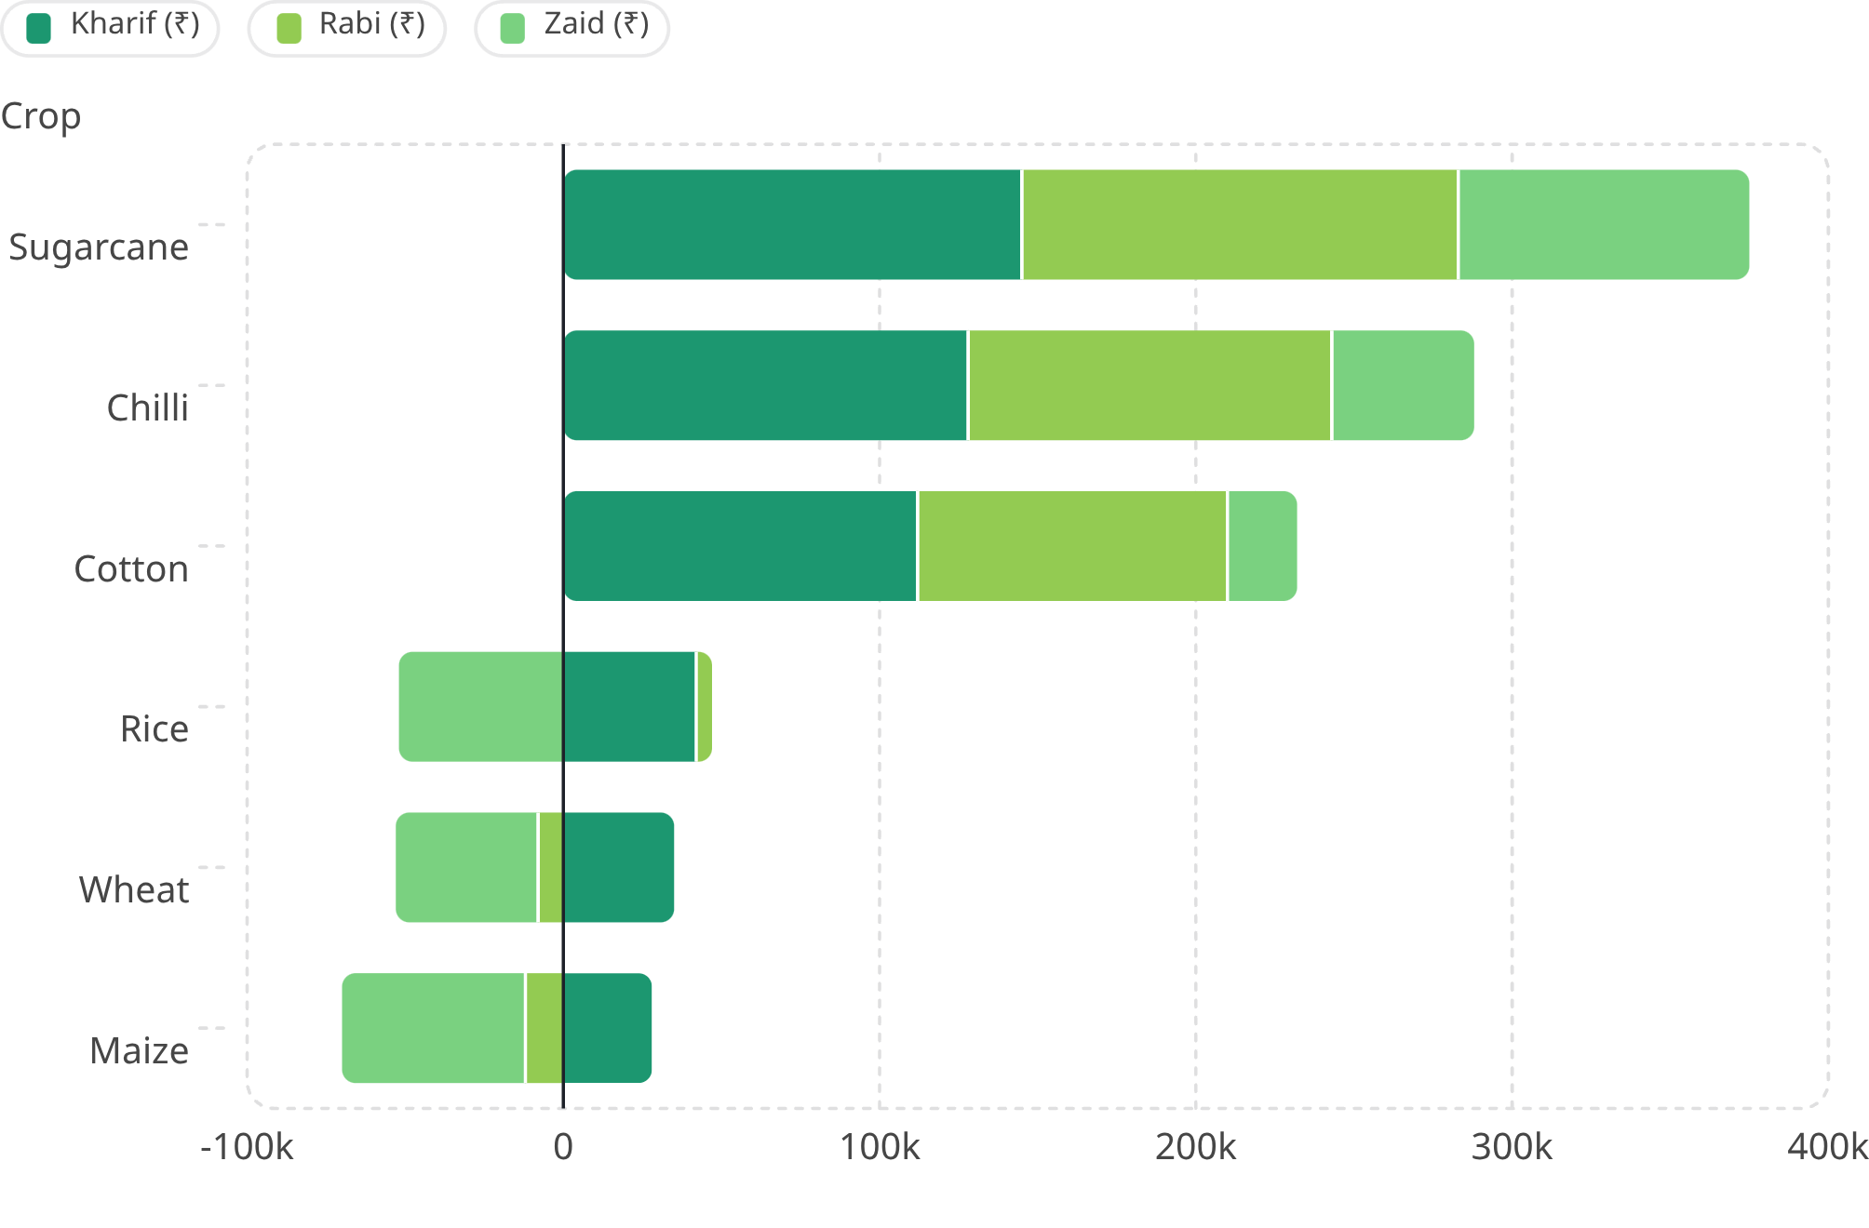
REGIONAL & CROP VARIATION
Regional & Crop-Wise Variation
Crop Profitability Across Seasons (₹)
Cash Crops Stay Profitable
Sugarcane, Chilli, and Cotton maintain positive returns across all three seasons. Crop selection is the most reliable profitability lever available.
Staple Grains Consistently Lose
Wheat, Rice, and Maize run losses in every season, with the deepest deficits in Zaid. Staples under Zaid conditions are economically indefensible without subsidy.
Punjab's Rabi Exception
Most states peak in Kharif, but Punjab peaks in Rabi at 8.45 t/ha — demonstrating that blanket seasonal recommendations fail in region-specific contexts.

Slide 8
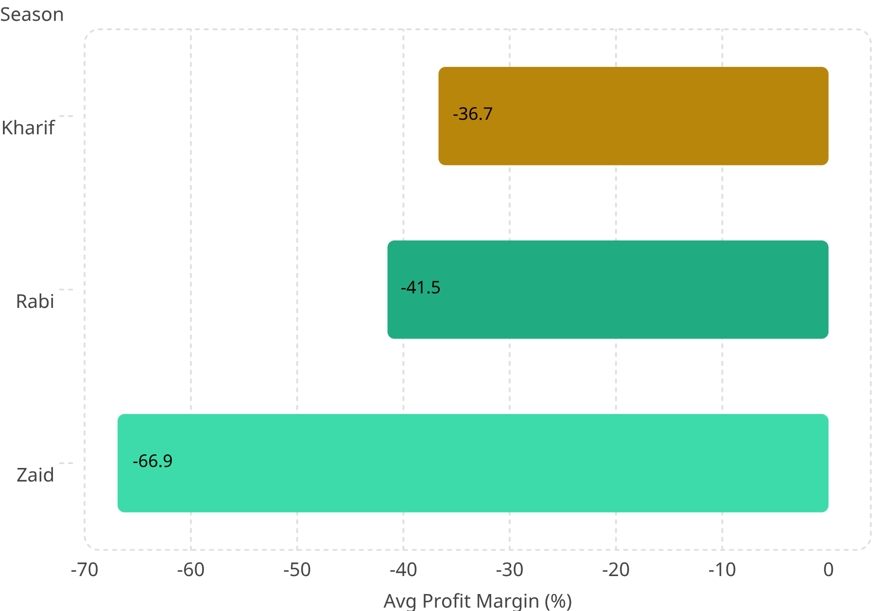

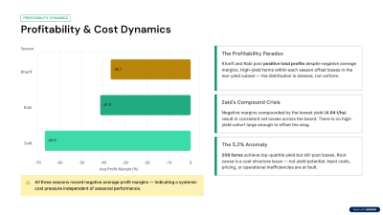
PROFITABILITY DYNAMICS
Profitability & Cost Dynamics
The Profitability Paradox
Kharif and Rabi post positive total profits despite negative average margins. High-yield farms within each season offset losses in the low-yield subset — the distribution is skewed, not uniform.
Zaid's Compound Crisis
Negative margins compounded by the lowest yield (4.64 t/ha) result in consistent net losses across the board. There is no high-yield cohort large enough to offset the drag.
The 5.2% Anomaly
209 farms achieve top-quartile yield but still post losses. Root cause is a cost structure issue — not yield potential. Input costs, pricing, or operational inefficiencies are at fault.
All three seasons record negative average profit margins — indicating a systemic cost pressure independent of seasonal performance.

Slide 9
KEY INSIGHTS
Key Insights
Five findings from the dataset that challenge conventional seasonal planning assumptions:
1
Profitability is Cost-Driven, Not Yield-Driven
Seasons differ significantly in profit (p<0.00001) but not in yield (p=0.28). Water efficiency (r=0.91) and cost structure are the true operational levers — not rainfall or temperature.
2
Irrigation is Misaligned With Seasonal Rainfall
Zaid over-irrigates at 6,420 m³/ha despite the lowest rainfall (299mm) and highest temperatures (31°C). This mismatch is the single most correctable inefficiency in the dataset.
3
Crop Selection Trumps Season Timing
High-value cash crops (Sugarcane, Chilli, Cotton) remain profitable year-round. Staple grains (Wheat, Rice, Maize) lose money in every season — worst in Zaid. Season is secondary to crop choice.
4
One-Size-Fits-All Seasonal Calendars Fail
Punjab's Rabi peak at 8.45 t/ha — outperforming its own Kharif — proves that regional agroclimatic variation makes blanket national recommendations suboptimal and potentially harmful.
5
High-Yield Farms Can Still Lose Money
209 farms (5.2%) achieve top-quartile yield but post net losses. This anomaly points to pricing failures, input cost overruns, or hidden operational inefficiencies that yield metrics alone cannot detect.

Slide 10

RECOMMENDATIONS
Recommendations for Seasonal Planning
Five evidence-based interventions ranked by systemic impact, derived directly from dataset findings:
Optimize Water Efficiency in Zaid
1
Reduce over-irrigation from the current 6,420 m³/ha benchmark. Shift to deficit irrigation, soil-moisture-triggered scheduling, or drought-tolerant crop varieties. Water efficiency at r=0.91 with yield makes this the highest-leverage intervention.
Rebalance Zaid Crop Mix
2
Prioritize high-value cash crops (Sugarcane: ₹92,000 Zaid profit; Chilli: ₹45,000) over loss-making staples (Maize: −₹58,000; Rice: −₹52,000). Crop substitution alone can reverse Zaid's average net loss of −₹23,235.
Build Region-Specific Seasonal Calendars
3
Conduct state-level audits — Punjab's Rabi advantage (8.45 t/ha) is suppressed by national Kharif-first policies. Tailor planting windows, crop recommendations, and resource allocation by agroclimatic zone.
Audit Cost Structure of High-Yield / Negative-Profit Farms
4
Investigate the 209 farms (5.2%) achieving top-quartile yield while posting losses. Identify whether the gap is driven by input procurement pricing, post-harvest losses, credit costs, or market access failures — then design targeted interventions.
Align Irrigation Method With Seasonal Water Availability
5
Match drip, sprinkler, or flood irrigation method to season-specific rainfall and crop water demand profiles. Kharif's 852mm rainfall supports flood; Zaid's 299mm demands drip or subsurface methods. Method misalignment drives the water usage paradox.
All recommendations are directly supported by statistically significant findings from the 4,000-record dataset. Priority sequencing reflects magnitude of estimated economic impact.

